Slide 1
Java EE Training Course
Servlets and JSP
Notes:
ATS Application Programming: Java Programming
Brown Bag: XML
© Accenture 2005 All Rights Reserved
Course Code #Z16325

Slide 2
Agenda
Web Components
Servlets overview
Servlet implementation
Request handling
Session management
Deployment Descriptor
JSP
Packaging
Notes:
ATS Application Programming: Java Programming
Brown Bag: XML
© Accenture 2005 All Rights Reserved
Course Code #Z16325

Slide 3
Web container
A web container is the component of a web server that interacts with Java servlets.
A web container handles requests to servlets, JavaServer Pages (JSP) files, and other types of files that include server-side code.
A web container implements the web component contract of the Java EE architecture.
Apache Tomcat is an open source web container available under the Apache Software License.
Notes:
Also known as a servlet container
The Web container creates servlet instances, loads and unloads servlets, creates and manages request and response objects, and performs other servlet-management tasks.
The Web container specifies a runtime environment for web components that includes security, concurrency, lifecycle management, transaction, deployment, and other services.
ATS Application Programming: Java Programming
Brown Bag: XML
© Accenture 2005 All Rights Reserved
Course Code #Z16325

Slide 4
Web Components
Servlets
Small Java programs that dynamically process requests and construct responses from a web browser. Servlets run within web containers.
Java Server Pages (JSPs)
Text-based documents that contain static template data such as HTML, Scalable Vector Graphics (SVG), Wireless Markup Language (WML), or eXtensible Markup Language (XML).
Notes:
When a web browser executes a Java EE application, it deploys server-side objects known as web components. JSP and corresponding servlets are two such web components.
ATS Application Programming: Java Programming
Brown Bag: XML
© Accenture 2005 All Rights Reserved
Course Code #Z16325

Slide 5
What is a Servlet?
A servlet is a Java programming language class
Java Servlet technology defines HTTP-specific servlet classes.
The javax.servlet and javax.servlet.http packages provide interfaces and classes for writing servlets.
All servlets must implement the Servlet interface.
The two classes in the Java Servlet API that implement the Servlet interface are GenericServlet and HttpServlet.
The HttpServlet class provides methods, such as doGet and doPost, for handling HTTP-specific services.
Notes:
A servlet is a Java programming language class used to extend the capabilities of servers that host applications accessed by means of a request-response programming model.
All servlets must implement the Servlet interface, which defines lifecycle methods.
For most purposes, Developers will extend HttpServlet to implement their servlets.
ATS Application Programming: Java Programming
Brown Bag: XML
© Accenture 2005 All Rights Reserved
Course Code #Z16325

Slide 6
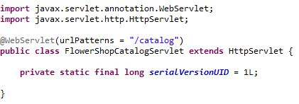
Creating and Initializing a Servlet
Use the @WebServlet annotation to define a servlet component in a web application.
Classes annotated with @WebServlet must extend the javax.servlet.http.HttpServlet class.
Notes:
@WebServlet is specified on a class and contains metadata about the servlet being declared.
The annotated servlet must specify at least one URL pattern.
The web container initializes a servlet after loading and instantiating the servlet class and before delivering requests from clients.
ATS Application Programming: Java Programming
Brown Bag: XML
© Accenture 2005 All Rights Reserved
Course Code #Z16325

Slide 7
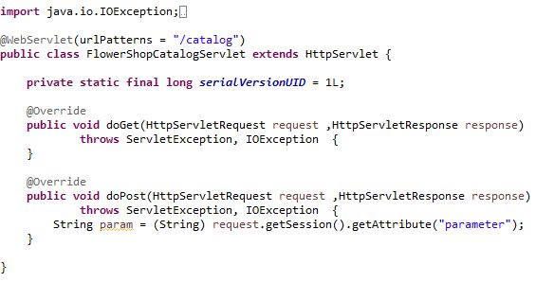
Request Handling Methods
The HttpServlet abstract subclass adds additional methods for processing HTTP-based requests:
doGet for handling HTTP GET requests
doPost for handling HTTP POST requests
Notes:
The basic Servlet interface defines a service method for handling client requests.
This method is called for each request that the servlet container routes to an instance of a servlet.
The GET method means retrieve whatever information (in the form of an entity) is identified by the Request-URI.
The POST method is used to request that the origin server accept the entity enclosed in the request as a new subordinate of the resource identified by the Request-URI in the Request-Line
ATS Application Programming: Java Programming
Brown Bag: XML
© Accenture 2005 All Rights Reserved
Course Code #Z16325

Slide 8
Session Management
HTTP protocol and Web Servers are stateless
Session is a conversional state between client and server and it can consists of multiple request and response between client and server.
There are several ways through which we can provide unique identifier in request and response:
User Authentication
Cookies
Session Management API
Notes:
HttpSession getSession() – This method always returns a HttpSession object. It returns the session object attached with the request, if the request has no session attached, then it creates a new session and return it.
Object getAttribute(String name) – Returns the object bound with the specified name in this session, or null if no object is bound under the name.
ATS Application Programming: Java Programming
Brown Bag: XML
© Accenture 2005 All Rights Reserved
Course Code #Z16325

Slide 9
Session and cookies
Example
  HttpSession session = request.getSession();
  session.setAttribute("user", “John");
  session.setMaxInactiveInterval(30*60);
  Cookie loginCookie = new Cookie("user", user);
  loginCookie.setMaxAge(30*60);
  response.addCookie(loginCookie);
  response.sendRedirect("LoginSuccess.jsp");

Slide 10
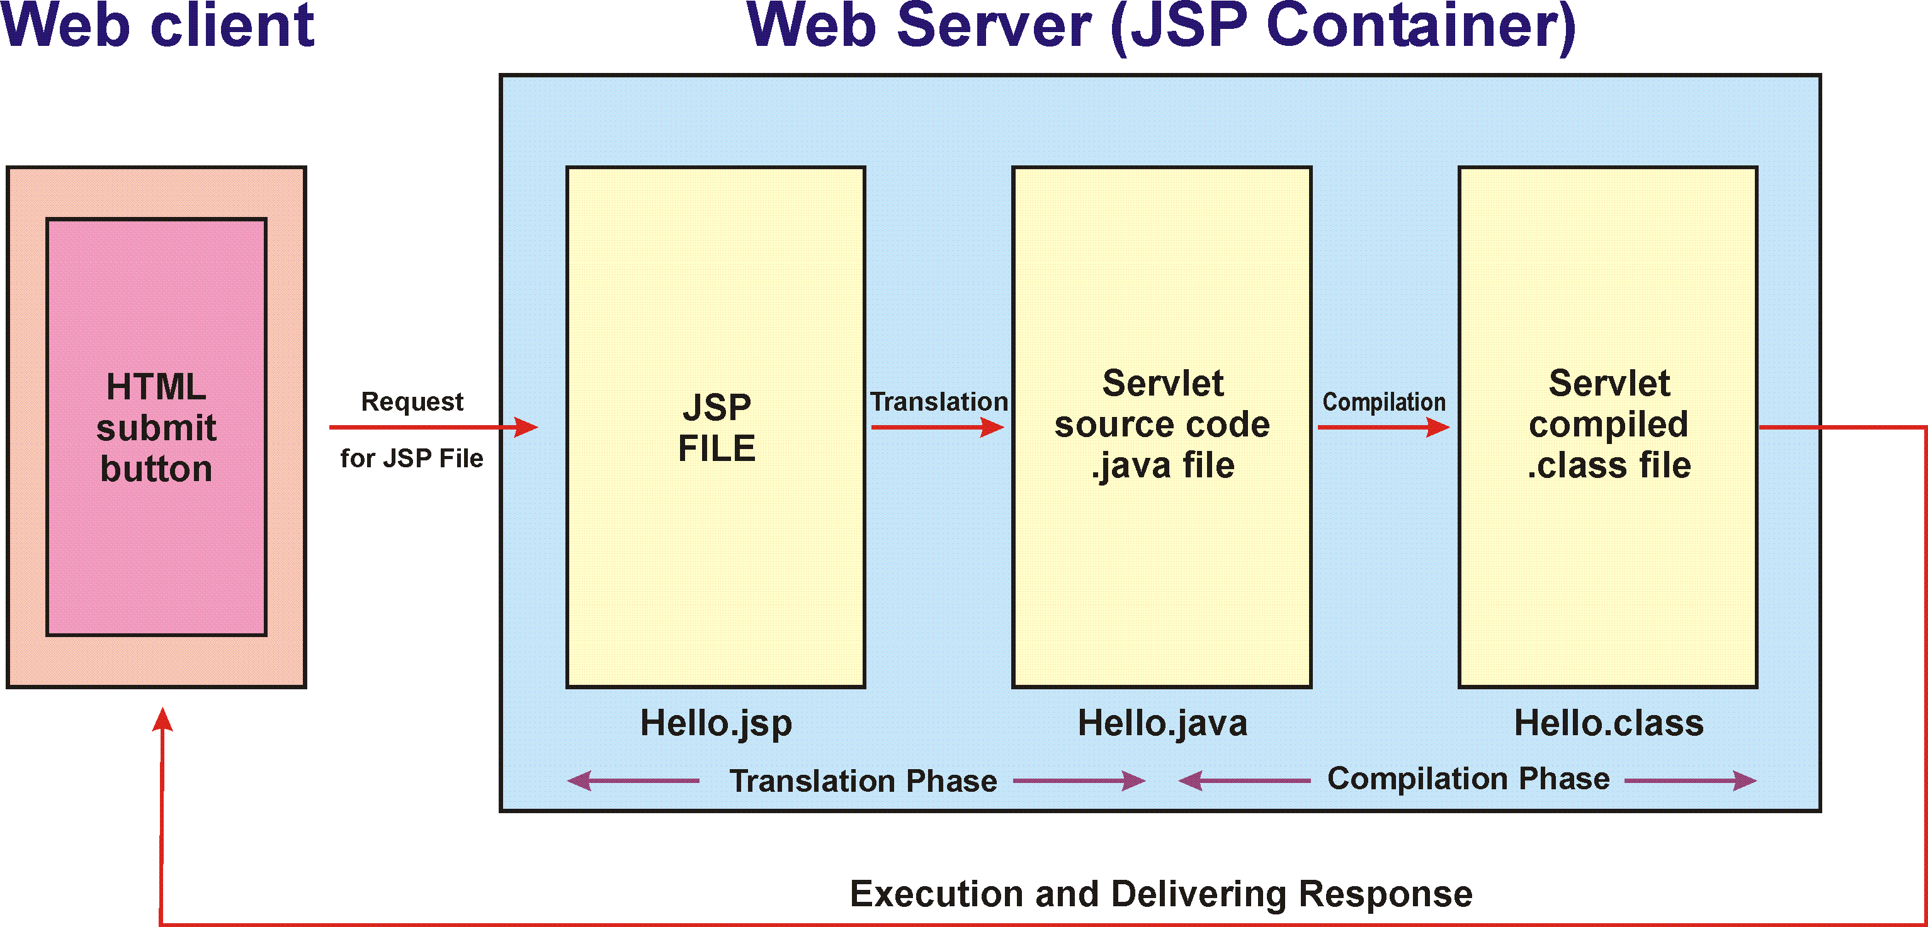
JavaServer Pages Technology
A JSP page is a text document that contains two types of text:
static data (such as HTML, SVG, WML, and XML)
JSP elements, which construct dynamic content
Notes:
A JavaServer Pages compiler is a program that parses JSPs, and transforms them into executable Java Servlets.
JSP enables the separation of content generation from content presentation.
The following steps explain how the web server creates the web page using JSP:
As with a normal page, your browser sends an HTTP request to the web server.
The web server recognizes that the HTTP request is for a JSP page and forwards it to a JSP engine. This is done by using the URL or JSP page which ends with .jsp instead of .html.
The JSP engine loads the JSP page from disk and converts it into a servlet content. This conversion is very simple in which all template text is converted to println( ) statements and all JSP elements are converted to Java code that implements the corresponding dynamic behavior of the page.
The JSP engine compiles the servlet into an executable class and forwards the original request to a servlet engine.
A part of the web server called the servlet engine loads the Servlet class and executes it. During execution, the servlet produces an output in HTML format, which the servlet engine passes to the web server inside an HTTP response.
The web server forwards the HTTP response to your browser in terms of static HTML content.
Finally web browser handles the dynamically generated HTML page inside the HTTP response exactly as if it were a static page.
ATS Application Programming: Java Programming
Brown Bag: XML
© Accenture 2005 All Rights Reserved
Course Code #Z16325

Slide 11
JavaServer Pages Standard Tag Library
JSTL is a collection of useful JSP tags which encapsulates core functionality common to many JSP applications.
Install JSTL Tag Library:
You should put the jar into your WEB-INF/lib
Declare it in your jsp
<%@ taglib prefix="c" uri="http://java.sun.com/jsp/jstl/core" %>

Slide 12
Core JSTL Tags
The <c:forEach> tag is the more commonly used tag because it iterates over a collection of objects.
Attribute | Description | Required | Default
items | Information to loop over | No | None
var | Name of the variable to expose the current item | No | None
varStatus | Name of the variable to expose the loop status | No | None

Slide 13
Core JSTL Tags
The <c:if> tag evaluates an expression and displays its body content only if the expression evaluates to true.
  <c:if test="${switchCondition eq 'false'}">
    <div>
    <button type="button" class="btn"></button>
    </div>
  </c:if>

Slide 14
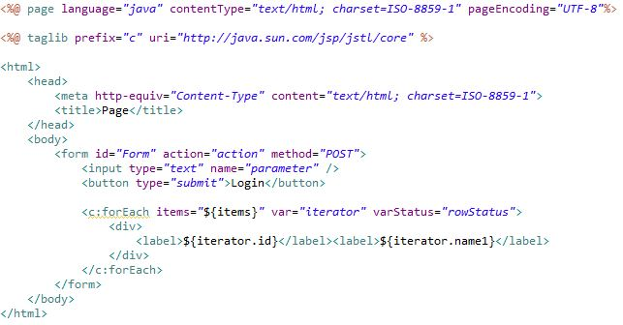
JSP Example
Notes:
A page directive (<%@page ... %>) sets the content type returned by the page.
Tag library directives (<%@taglib ... %>) import custom tag libraries.
JSP expression language expressions (${ }) retrieve the value of object properties.
Custom tags set a variable (c:set), iterate over a collection of locale names (c:forEach), and conditionally insert HTML text into the response (c:if, c:choose, c:when, c:otherwise).
ATS Application Programming: Java Programming
Brown Bag: XML
© Accenture 2005 All Rights Reserved
Course Code #Z16325

Slide 15
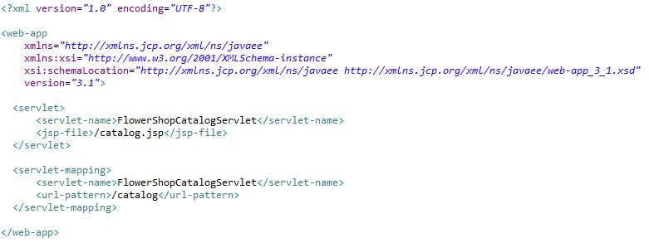
Web Application Deployment Descriptors
This file is named web.xml, and resides in the app's WAR under the WEB-INF/ directory.
With Java EE annotations, the standard web.xml deployment descriptor is optional.
Notes:
web.xml describes the classes, resources and configuration of the application and how the web server uses them to serve web requests.
Java web applications use a deployment descriptor file to determine how URLs map to servlets, which URLs require authentication, and other information.
ATS Application Programming: Java Programming
Brown Bag: XML
© Accenture 2005 All Rights Reserved
Course Code #Z16325

Slide 16
Packaging
Web components are packaged in WAR files.
Each WAR file contains servlets, JSPs, a deployment descriptor, and related resource files.
Static HTML files and JSP are stored at the top level of the WAR directory.
The top-level directory contains the WEB-INF subdirectory which contains tag library descriptor files in addition to the following:
Server-side classes
Auxiliary JARs
web.xml
Notes:
Server-side classes contains Servlets, JavaBean components and related Java class files. These must be stored in the WEB-INF/classes directory.
Auxiliary JARs contains Tag libraries and any utility libraries called by server-side classes. These must be stored in the WEB-INF/lib directory.
web.xml. The web component deployment descriptor is stored in the WEB-INF directory.
ATS Application Programming: Java Programming
Brown Bag: XML
© Accenture 2005 All Rights Reserved
Course Code #Z16325

Slide 17
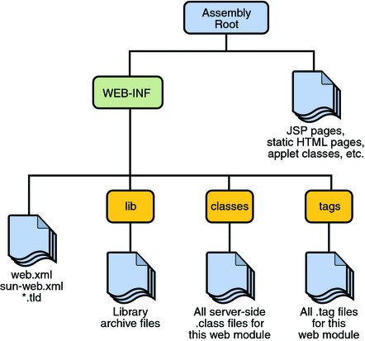
Web Module Structure

Slide 18
Self study materials
Servlet Filters
http://docs.oracle.com/cd/B14099_19/web.1012/b14017/filters.htm
jQuery Events
https://api.jquery.com/category/events/
Bootstrap
http://www.w3schools.com/bootstrap/
Bootstrap Grid System
https://v4-alpha.getbootstrap.com/layout/grid/

Slide 19
Activity. Part 1
  Create login page with
    Form with login/password inputs
    Login button calling Login servlet with form data
    Register button forwarding to register page
  Create register page with
    User info inputs(login, name, password, etc.)
    Register button calling Register servlet with form data
  Create main page with
    Logged user info (name, discount, balance) from session
    Logout button erasing session and forwarding to login page
! Check article if fields are not shown correctly in jsp page
https://stackoverflow.com/questions/2168832/expression-language-in-jsp-not-working

Slide 20
Activity. Part 2
  Fill User and UserDto classes with user attributes
  Create login servlet
    Pass data to business service
    If logged successfully, put user into session, redirect to main page
    Else show error
  Create register servlet
    Pass data to business service
    Redirect to login page
To emulate DB work in UserAccesService create Map<String, User> storage to store users, implement UserAccesService methods accordingly
! Check article to inject beans in servlets
https://stackoverflow.com/questions/11843690/autowiring-in-servlet

Slide 21
Questions
???
Notes:
ATS Application Programming: Java Programming
Brown Bag: XML
© Accenture 2005 All Rights Reserved
Course Code #Z16325

